Slide 1


AGENTVERSE 2026 · BIOTECH TRACK · TEAM BACKPROP TO THE FUTURE
Which drug pairs should a lung cancer lab test next?
5,460
drug pairs
...but only a budget for 50
LungPair ranks drug combinations
for non-small cell lung cancer labs:
save time and money, change lives.
Notes:
A lab with a $30,000 grant can run about 50 pairs out of 5,032. The question is not which combinations work. It is which 50 to try.

Slide 2
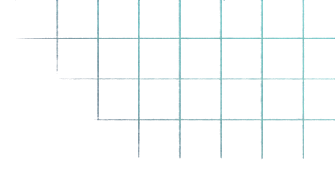




THE PROBLEM
Three bottlenecks
between the lab and the patient
1
2
3
Too many pairs,
too little budget
Old drugs
are a shortcut
Too many pairs, no way to choose
On osimertinib alone, 16 .7 month progression for EGFR+ NSCLC
With a second treatment, extended to 25.5 months.
The question is which pair?
Labs currently choose
by literature review and intuition.
105 approved drugs → 5,460 possible pairs → 187,460 triplets.
Re-testing the 5,032 measured pairs in 9 lung cell lines alone
is ~45,000 experiments.
Approved drugs have known safety profiles.
$300 million vs $2-3 billion
to bring to market
Repurposing pathway: Kulkarni et al., Russ J Bioorg Chem 2023.
Cost: illustrative core-facility rate, 9 lung lines per pair.
Notes:
Three bottlenecks. The cost figure is illustrative, not a quote.

Slide 3
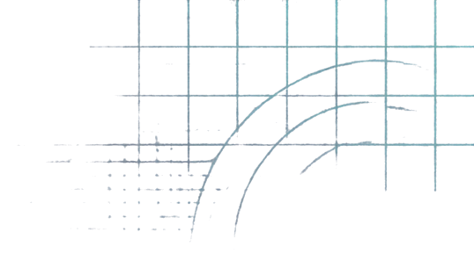



WHO IT'S FOR
Built for lab researchers, not patients
WHO USES IT
WHAT IT GIVES THEM
Academic NSCLC labs
A ranked shortlist of pairs to screen next
Lab technicians and
translational teams
A confidence tier on every pair,
with measured precision
A refusal when the evidence runs out
Screening cores and CROs (B2B)
A researcher signs off every shortlist
Research use only.
A ranked pair is a hypothesis from cell-line data, not treatment advice.

Slide 4
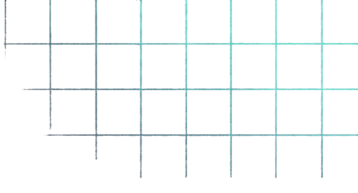





















THE PIPELINE
From public screens
to a shortlist you can audit
Agents: Google Gemini. Models never compute a number; every score comes from the ranker.
1
2
3
4
5
6
Orchestrator
Ranker:
Research agent:
Checks:
Researcher
Receipt:
resolves drugs, calls the ranker
score, tier,
95% interval
mechanism + PubMed IDs
5 code gates + checker
signs off
every call
logged
T4
refused,
returned as withheld.
Held-out results (5 seeds)
Confidence tiers (measured precision)
0.89
0.61
0.82
0.71
Tier
Definition
Measured
Lift vs baseline
precision@20
precision@50
AUPRC
MCC@50
T1
pair measured in another cancer
0.89
24.0x
precision@50 throughout
T2
both drugs screened, pair untested
0.34
11.0x
LungPair
0.61
shuffled labels
0.06
T3
new drugs, monotherapy known
0.06
3.0x
random
0.03
T4
no evidence
0.04
refused
Hit prevalence 3.3%, so accuracy is not reported.
Sources: NCI DTP NCI-ALMANAC (ComboDrugGrowth_Nov2017); O'Neil et al. Merck screen.
Held-out pairs, 5 seeds.
Notes:
Every score comes from the ranker. No language model computes a number — if one did, none of these validation figures would describe the running model.

Slide 5
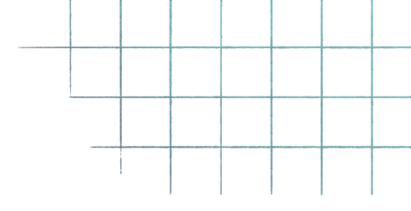



EXTERNAL CHECK
The premise replicates on another lab’s screen
1
Test 1
2
Test 2
Rebuilt inside the Merck / O’Neil screen
Our own model, on shared pairs
0.81
rank correlation, other-cancer
synergy vs lung synergy
(583 pairs)
+0.27
rank correlation with
Merck lung results
(p = 0.002)
90%
top 20 precision:
90% hits against a 25% base rate (p < 0.0001)
Weaker, and we say so: the top-10 enrichment (40% vs 19%) is not significant at p = 0.087.
100%
on 5 lung lines never
in NCI-ALMANAC:
100% vs 26%
The premise replicates; this model’s cross-screen agreement is modest.
O'Neil et al. 2016 Merck screen via MTLSynergy.
Different lab, different synergy metric, different cell lines.
Notes:
Lead with Test 1 — it is the stronger claim and it is not our data. State Test 2 honestly; volunteering the non-significant result is what makes the first one believable.

Slide 6

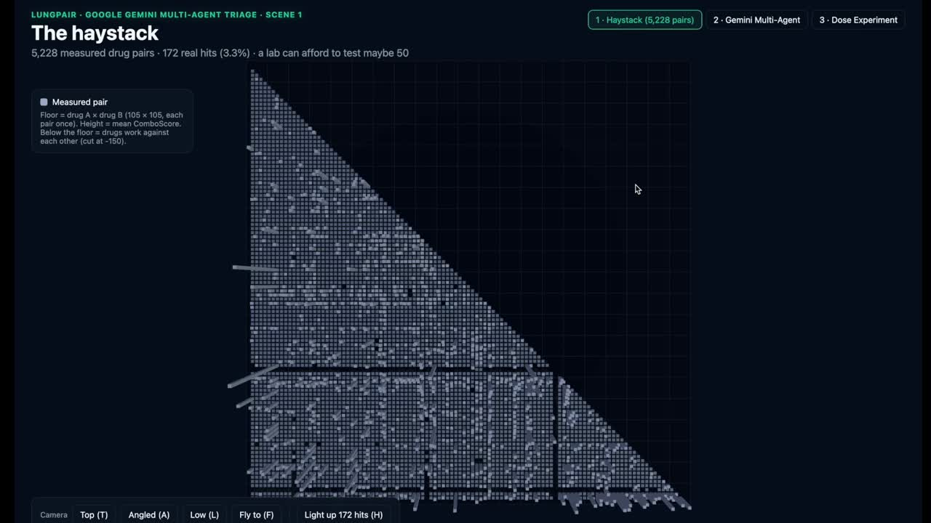



Open this link: https://yonghwa11701-hash.github.io/lungpair-3d-visual/
LIVE DEMO
The agent at work
1
3D landscape of
every measured pair
2
A judge asks:
which partner for gefitinib?
3
Agents rank,
research and check
4
Researcher approves
the batch; receipt saved
The 3D view replays measured NCI-ALMANAC results, not predictions.
The agent runs live on public cell-line data. No patient data.

Slide 7
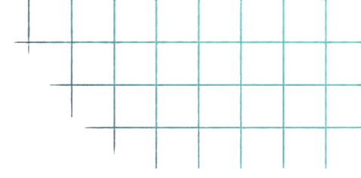



THE BUSINESS CASE · ILLUSTRATIVE
Lower cost per real hit
Strategy
Pairs
Cost
Real hits
Cost per hit
Test every pair
5,228
$16.0M
172
$93,000
18x
Random 50
50
$153,000
~1.7
$93,000
LungPair top 50
$4,900
cheaper per real hit
than random selection, at the same budget.
(pair seen in another cancer)
50
$153,000
31
LungPair top 20
20
$61,200
~7
$8,700
(brand-new pairs)
Illustrative: $340 per experiment (one pair, one cell line, academic core rate), 9 lung lines per pair. Hit counts from an earlier run, to be updated.
Notes:
Flag this as illustrative out loud. The per-experiment rate is a core-facility estimate, not a quote.

Slide 8
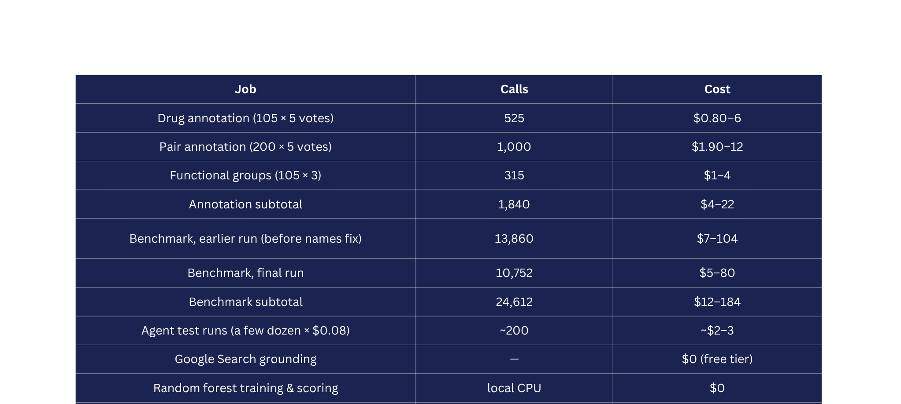
THE BUSINESS CASE · ILLUSTRATIVE
Lower cost per real hit
Notes:
Flag this as illustrative out loud. The per-experiment rate is a core-facility estimate, not a quote.

Slide 9
THE BUSINESS CASE · ILLUSTRATIVE
Gemini vs other LLM
Benchmark
Gemini 4 Argon
GPT-5.2 Astra
Claude Fable 5.1
Claude Opus 5.5
Knowledge work
Vals Index
68.9%
63.1%
65.8%
67.0%
AutomationBench
51.3%
41.4%
31.4%
42.5%
Vals Finance Bench v2
65.4%
53.5%
58.9%
58.6%
Agentic coding
Harvey's Legal Agent Benchmark
19.6%
5.4%
6.7%
3.8%
DeepSWE v1.1
77.9%
74.1%
67.4%
74.2%
FrontierSWE v2
55.0%
65.5%
56.3%
62.3%
Vibe Code Bench
91.9%
89.6%
90.3%
90.3%
Terminal-bench 4.0
57.4%
58.2%
57.9%
66.4%
PostTrainBench
45.3%
44.3%
40.2%
49.3%
Science and math
Terminal-Bench Science 0.1
57.6%
68.1%
52.6%
63.3%
LABBench 2
88.8%
85.4%
68.6%
73.1%
LlamaBench
76.0%
72.0%
65.6%
69.6%
Long context
GrepWalks
99.7%
98.7%
91.4%
90.6%
LongBench v2
84.2%
71.8%
65.0%
66.8%
Computer use
OSWorld-2.0
39.5%
34.2%
—
38.2%
Chartergraph
69.2%
72.6%
—
—
Multimodal understanding
LVGLBench
91.7%
87.5%
79.7%
83.7%
Cybersecurity
CWE-bench v1
68.0%
68.0%
58.0%
67.0%
Methodology: deepmind.google/models/evals-methodology/gemini-4-argon
Notes:
Flag this as illustrative out loud. The per-experiment rate is a core-facility estimate, not a quote.

Slide 10




REGULATORY AND SAFETY
Research tool now. Regulated tool later.
Risk
Mitigation
Read as treatment advice
Researcher-only scope; patient and dose questions refused before any model call.
1
NOW
Research tool on public
cell-line data.
Invented citations
Every PMID, DOI and URL must appear in the search grounding,
or it is removed and flagged.
No patient data.
Research use only.
Invented or wrong numbers
Every number in the summary
must exist in the ranker's output.
2
LATER · TO CONFIRM
Confident guesses
with no evidence
Tier 4 refused and listed as withheld;
drugs outside the panel refused.
Clinical decision support
from blood ctDNA.
Likely regulated as software as a medical device;
needs separate validation.
Agent acts
without approval
Cannot order, buy or run anything;
researcher signs off each batch;
every call logged.
Gates are plain code, not a model.
A checker ‘pass’ never cancels a gate ‘fail’.

Slide 11
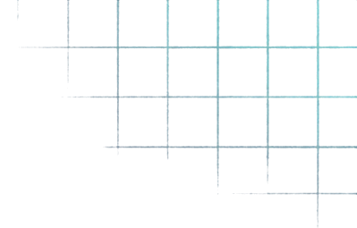












IMPACT AND NEXT STEPS · ROADMAP, NOT BUILT
Re-rank before resistance sets in
1
WHY COVERAGE MATTERS
Blood ctDNA at baseline, then at set intervals
18
5
2
pairs were hits in every lung cell line they were tested in, across all 9 lines.
Lab results feed the next ranking
New mutation flagged
(e.g. KEAP1, STK11)
LIMITS
4
3
Needs consented serial ctDNA and outcome data.
Clinician or researcher approves
LungPair re-ranks pairs by coverage
Blood assays detect copy-number changes and fusions poorly.
LungPair.
Fewer experiments, more real hits.
Pascual et al., Ann Oncol 2022 (ESMO ctDNA recommendations); Kulkarni et al., 2023.

Slide 12


